Slide 1


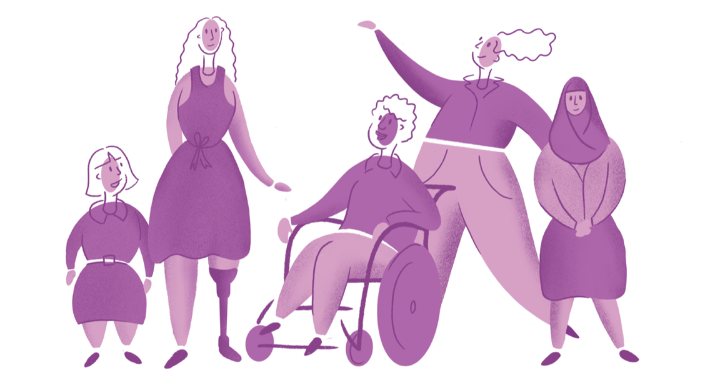
Our Site – a website by and for women and girls with disability
oursite.wwda.org.au
Notes:
Our Site is a new website that Women with Disabilities Australia has created – it is by and for women, girls (aged 15 years and older), feminine-identifying and non-binary people with disability.
You can visit the website at oursite.wwda.org.au
In this presentation I am going to tell you a bit about what the website is, how it was created, who was involved and how you can find out more.

Slide 2
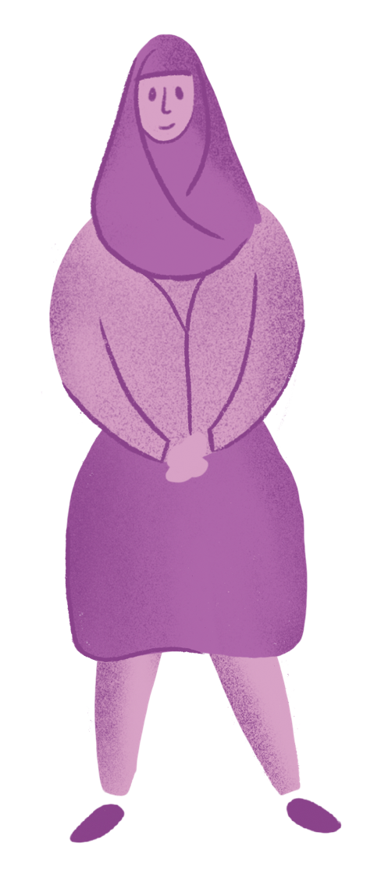
What is Our Site?
A website by and for women and girls with disability.
Information and resources to support women and girls with disability to learn about and stand up for their rights.
Created because women with disability asked for it.
oursite.wwda.org.au
Notes:
Our Site provides engaging and practical information and resources in a range of different formats to support women and girls with disability to learn about and stand up for their rights.
Our Site was created because women with disability asked for it.
For many years the community of women with disability have told WWDA that there is a lack of high quality information available that is accessible and relevant to issues affecting their daily lives.
Our Site was created to address this need.

Slide 3





What is Our Site?
Information across 5 main areas:
 | Your Rights | Information on the rights of women and girls with disability, including United Nations Conventions and Australian laws.
 | Lead and Take Part | Information about being a leader and taking part in every aspect of your community including work, education and hobbies.
 | Life Choices | Information that supports your right to make your own decisions about all parts of your life including money, housing and health.
 | Sex and Your Body | Information about your right to express your gender and sexuality, to have relationships and to raise a family.
 | Safety and violence | Information on your right to be free from any form of violence, and how to get help if you need it.
Notes:
The information on Our Site is divided into 5 priority areas. These areas were selected by women and girls with disability.
The Your rights section provides information on the human rights of women and girls with disability, including United Nations Conventions, Australian and state-based laws. It also provides information on Police Courts and prisons, as well as discrimination and how to make a complaint.
The Lead and Take Part section provides information about being a leader and taking part in every aspect of your community. This includes information on work, education, hobbies, mentoring, Boards and Committees and leadership organisations.
The Life Choices section provides information that supports your right to make your own choices and decisions in everyday life. This includes decisions about money, housing, healthcare and lifestyle. This section also provides information on preparing for national disasters and emergencies. It currently also has a page dedicated to COVID-19.
The Sex and Your Body section provides information about your right to express your gender and sexuality, to have relationships and to raise a family. It also contains information on sex, consent, contraception, body image and women’s health.
The Safety from Violence section provides information on your right to be free from any form of violence. This includes information on the different types of violence, how to get support if you need it and also how you can participate in the Disability Royal Commission.
Within each section on Our Site there are lots of different pages.
Once you go into one of these pages, you will find lots of information as well as downloadable resources, videos, images and links.

Slide 4
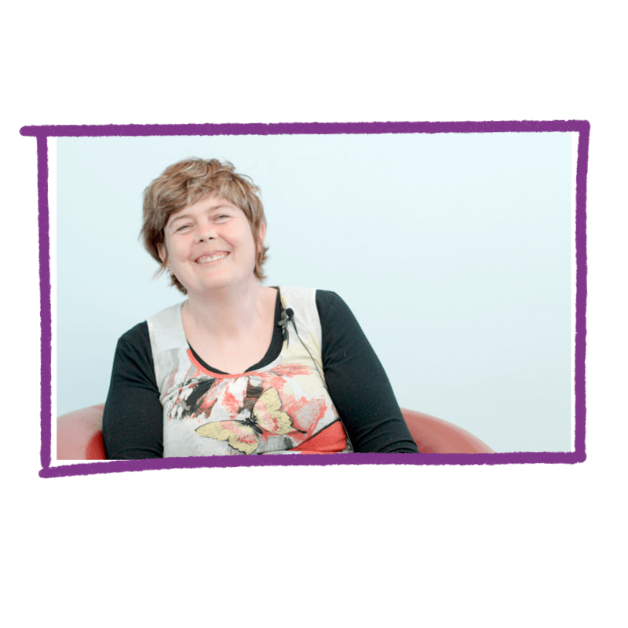
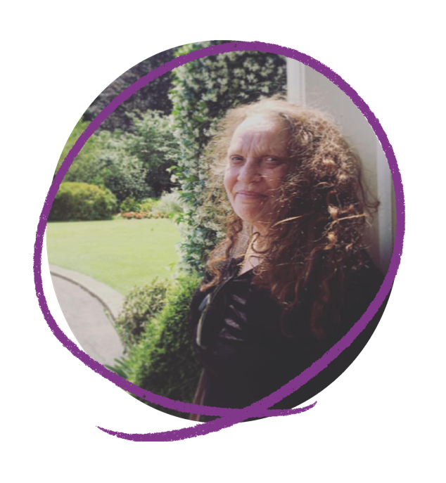
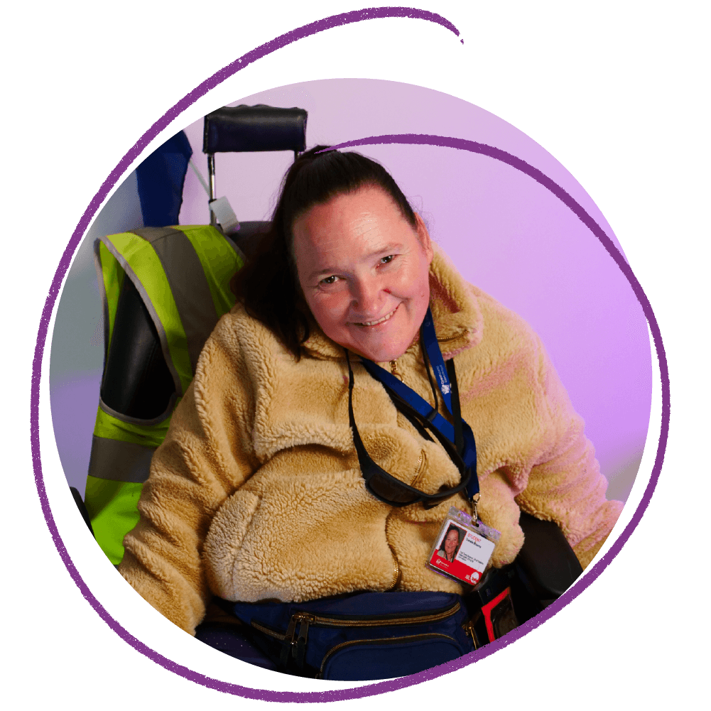
What is Our Site?
Over 40 real stories from women with disability around Australia.
Notes:
Our Site also has a Real Stories section.
This section provides written, video and audio stories from over 40 women with disability across Australia.
The Real Stories section is one of the most popular parts of the website. In their stories, women share their personal experiences, providing relatable, real-life insights into the concepts addressed on Our Site.

Slide 5
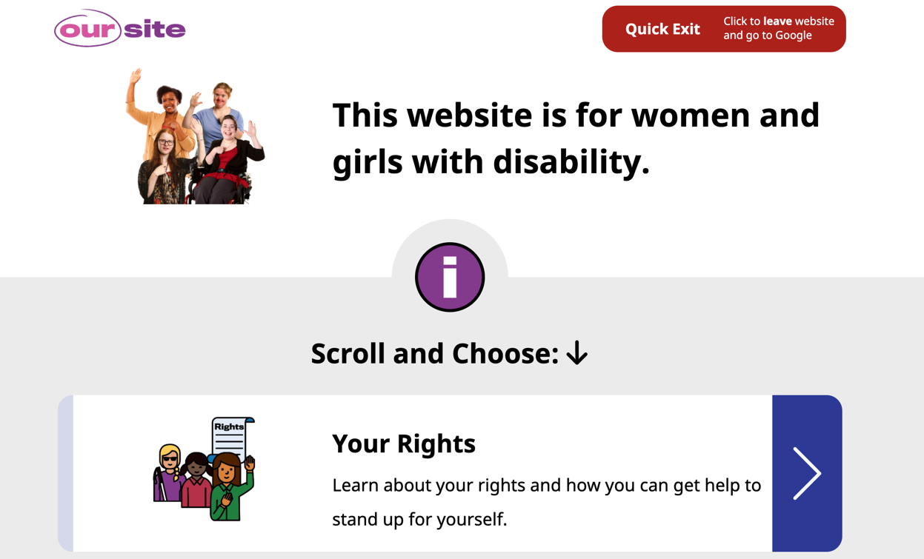
What is Our Site?
Easy Read version
For women with intellectual disability, low literacy and some women whose first language is not English.
Notes:
You can also view Our Site content in “Easy Read” mode. Easy Read uses simple and easy to understand language and images. It can be useful for women with intellectual disability, low literacy and/or women whose first language is a language other than English.

Slide 6

Who created Our Site?
Led by Women with Disabilities Australia (WWDA).
WWDA is the national organisation representing over 2 million women an girls with disability in Australia.
WWDA received money from the National Disability Insurance Agency (NDIA) to create Our Site.
wwda.org.au
Notes:
The Our Site website is the result of a two year national project led by Women With Disabilities Australia (WWDA).
WWDA is a national organisation that represents the more than 2 million women and girls with disability in Australia.
The key purpose of WWDA is be a national voice for the rights of women and girls with disability and a force to improve the lives of women and girls with disability.
WWDA does research and advocacy work that includes writing documents such as policy submissions, reports for government and media statements. WWDA also implements projects to advance and support the rights of women with disability, such as the Our Site project.
WWDA received funding through the National Disability Insurance Agency’s Information, Linkages and Capacity Building Program to create Our Site.

Slide 7
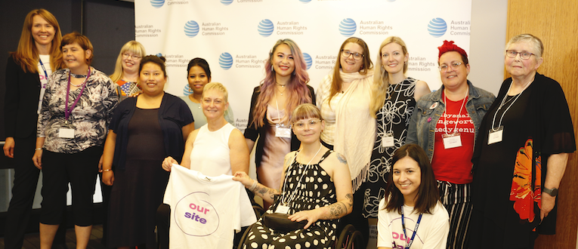
Who created Our Site?
WWDA engaged over 100 other women with disability.
WWDA made sure that women with disability were involved in every stage of the project. This is called a co-design approach.
Women with disability were involved in governance committees, advisory panels, workshops and user testing activities.
Notes:
The Our Site website is different in that it was created using a co-design approach. This means that WWDA made sure that women with disability were meaningfully involved in every aspect of the website’s creation.
The project was led and governed by women with disability, who then facilitated involvement of a wide, diverse group of additional women with disability.
In total, over 100 women with disability from across Australia were involved in the Our Site design and development process.
Women with disability were engaged in lots of different ways. They provided leadership through the WWDA Board and a Project Steering Committee. They provided input into the content and design through workshops and advisory panels. They also had numerous opportunities to test the website as it was developed and provide feedback.

Slide 8
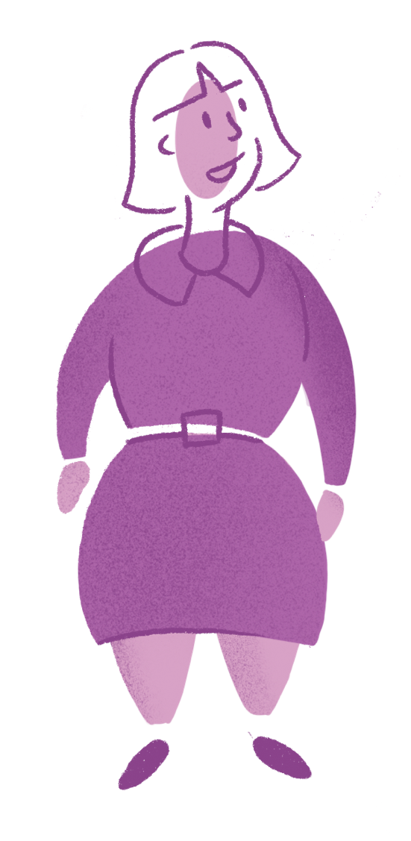
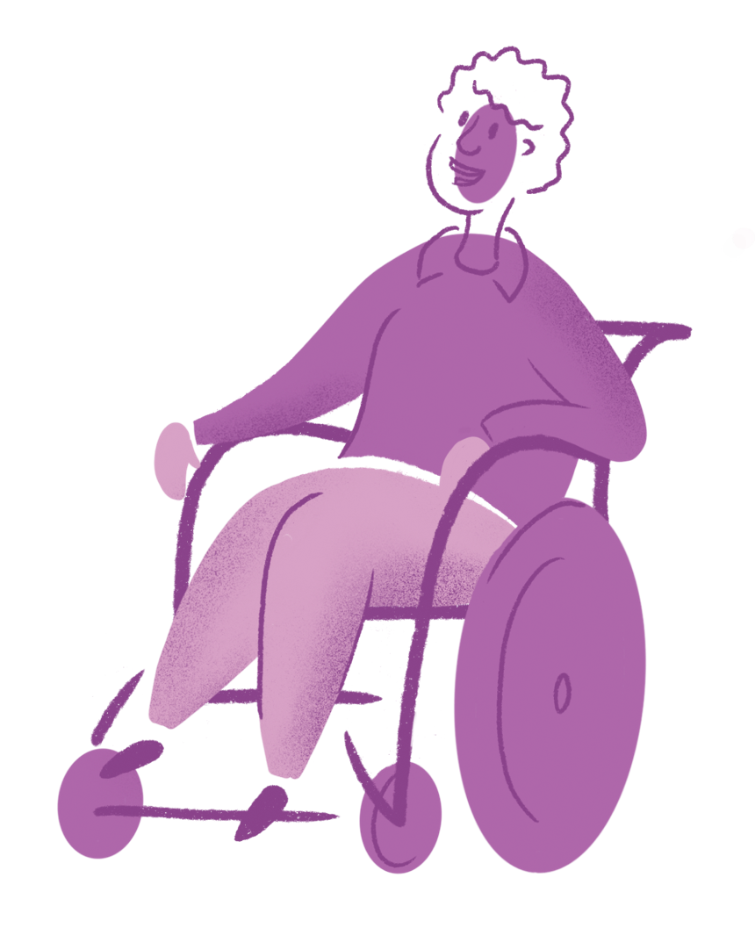
Quotes from contributors
“Women and girls with a disability joined hearts and minds to create Our Site with their own personal experiences, stories and expertise”
“The fact that the input was all from women with disability made me feel that the content was authentic.”
“People with disability own Our Site and no one can take this from us. Our Site can be our voice.”
Notes:
The co-design development process has resulted in a website that is truly owned by the community of women with disability.
Participants feel proud of their contribution and many say they have gained confidence through their involvement. Some participants have experienced benefits in their workplaces and careers. Many have benefited on a personal level through making new connections and friendships with other women with disability.
Here are some quote from women involved.

Slide 9
How can I get involved?
Take a look at the site by visiting oursite.wwda.org.au
Visit the Contribute page to give us feedback or share your story
Visit the About page and download the report to learn more
Join the WWDA Facebook group.
You can check out WWDA on:
Web: wwda.org.au
Facebook: WWDA.Australia
Twitter: WWDA_AU
Instagram: wwda_au
Notes:
There are lots of ways that you can get involved.
Firstly – make sure you check out the website at oursite.wwda.org.au
Once you are there you can visit the Contribute page to provide feedback. You can also tell us if you would like to share your story on the website.
If you visit tthe ‘About’ page, you will find a link to the Our Site report that provides alot more information on how we created Our Site.
If you are a woman or girl with disability, you can also join the linked WWDA Facebook Group. This group is a warm and friendly space for women and girls (aged 15 years and above) with disability to share ideas, questions and experiences about living in Australia with disability.
Finally – make sure you check out the WWDA website and follow WWDA on Facebook, Twitter and Instagram.

Slide 10
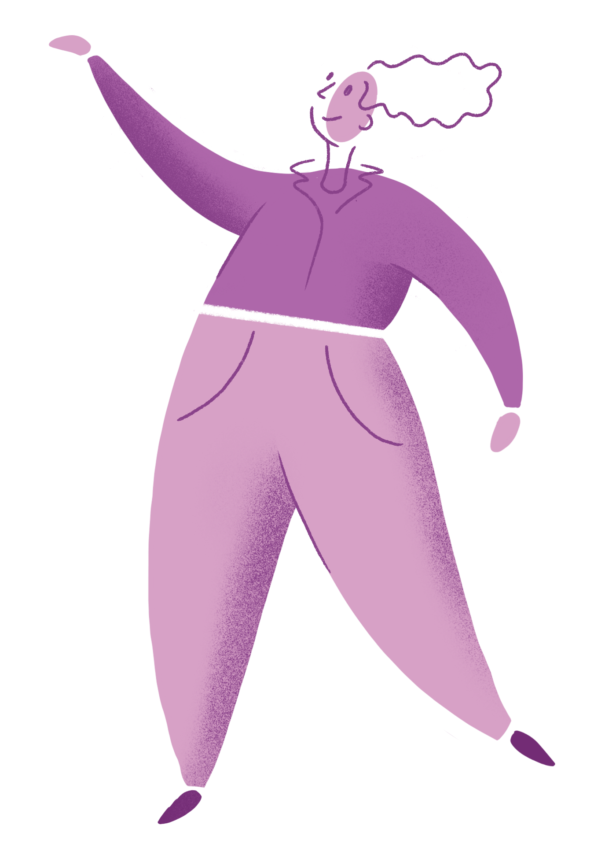
Thank you!
Contact: oursite@wwda.org.au
Notes:
Thank you for listening.
If you would like to find out more you can contact the Our Site team by emailing oursite@wwda.org.au

