Slide 1
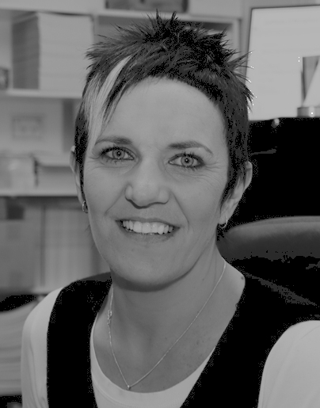
‘Moving Forward & Gaining Ground: The Sterilisation of Women and Girls with Disabilities in Australia’
Paper written by Carolyn Frohmader and presented by Karin Swift on behalf of Women with Disabilities Australia (WWDA)
© WWDA 2012

Slide 2
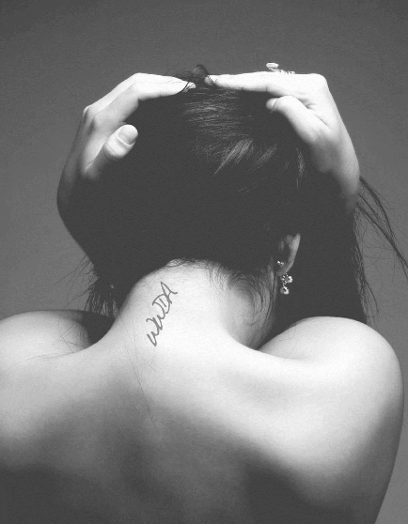
Women with Disabilities Australia
Is the national peak NGO for women with all types of disabilities.
Uses a human rights based framework which links gender and disability issues to civil, political, economic, social and cultural rights.
Is run by women with disabilities, for women with disabilities.
Is committed to promoting and advancing the human rights and fundamental freedoms of women with disabilities.
Policy priorities include: sexual & reproductive rights; violence; parenting.

Slide 3
Introduction
Bella is 34 years old. Without her knowledge or consent, she became the victim of forced sterilisation at the age of 12 when her parents took her to hospital for what they told her was an operation to have her appendix removed. Nine years later, during a routine pelvic examination, Bella was told it was her uterus, not her appendix that had been removed. Thirteen years on from her discovery, Bella’s grief and anger are still raw. The trust she had in her parents and hospital staff, she explains, was violated. “If they’d told the truth and asked me, I would have shouted ‘No!’” “My sterilisation makes me feel I’m less of a woman when I have sex because I’m not normal down there,” says Bella. “When I see other mums holding their babies, I look away and cry because I won’t ever know that happiness.” [1]
Notes:
[1] Osfield, S. (2012) ‘This girl has special needs and one day dreams of being a mum. Does anyone have the right to stop her having a baby?’ In marie claire magazine, June 2012.

Slide 4
What do we mean when we talk about forced sterilisation of disabled women and girls?
Systemic prejudice and discrimination
Denial of the right to experience sexuality
Is an act of unnecessary and dehumanising violence
Is a form of torture
Is about social control
Disproportionately affects disabled women and girls

Slide 5
Why are women and girls with disabilities still being sterilised?
The reasons used to justify forced sterilisations generally fall into four broad categories, all couched as being in the “best interests” of women and girls with disabilities:
1. The genetic/eugenic argument
2. For the good of the state, community or family
3. Incapacity for parenthood
4. Prevention of sexual abuse

Slide 6
1. The Genetic/Eugenic Argument
“The result will be complete absence of menstruation and this will undoubtedly be of benefit to H who already appears to have substantial difficulties with cleanliness…….. As a by-product of an absence of her uterus H will never become pregnant. Given the genetic nature of her disorder and the 50% inheritance risk thereof, this would in my view be of great benefit to H.” [2]
Medical Specialist 2004
Notes:
[2] Re H [2004] FamCA 496 (20 May 2004)

Slide 7
2. For the good of the state, community or family
“Undoubtedly and certainly of significant relevance is that there are hygiene issues which must fall to the responsibility of her mother because Angela cannot provide for herself….. the operation would certainly be a social improvement for Angela’s mother which in itself must improve the quality of Angela’s life.” [3]
Obstetrician and Gynaecologist 2010
Notes:
[3] Re: Angela [2010] FamCA 98 (16 February 2010)

Slide 8
3. Incapacity for parenthood
“ Those who are severely intellectually disabled remain so for the rest of their lives.” [4]
Clinical Psychologist
“There is no prospect that will ever show any improvement in her already severely retarded mental state.” [5]
Specialist Paediatric Surgeon

Slide 9
4. Prevention of sexual abuse
“It is highly unlikely that Katie will ever have the capacity to understand and voluntarily enter into a sexual relationship..... It is however well documented that disabled children are particularly vulnerable to sexual abuse and Katie is quite an attractive girl.” [6]
Early Childhood Psychologist
Notes:
[6] In the Matter Of: Re Katie Number of Pages - 29 Children - Welfare of Child - Medical Procedures [1995] FamCA 130 (30 November 1995)

Slide 10
“It is unlikely she will have any form of relationship involving sexual intercourse. She could, of course, be the victim of a sexual assault and with her normal physical development and attractive looks that cannot be discounted.” [7]
Judge, Family Court
Notes:
[7] Re A Teenager [1988] FamCA 17 (15 November 1988)

Slide 11
“Ever since Elizabeth was a very young child, she was prone to run to men. If her mother takes her out she will go to any man, including strangers. On many occasions in public when the mother has not been holding Elizabeth tightly, she has run over to a man who is a complete stranger and taken his arm. She shows no fear and would happily go off with any man. She has to be physically restrained from chasing after men in public and throwing her arms around them.” [8]
Judge, Family Court
Notes:
[8] Re Elizabeth Suit [1989] FamCA 20 (3 May 1989)

Slide 12
“There is unlikely to be any psychological impact of the procedure on H as she has no understanding of the nature of the procedure.”[9]
Judge, Family Court
Notes:
[9] Re H [2004] FamCA 496 (20 May 2004)

Slide 13
Women With Disabilities Speak Out
“It has resulted in loss of my identity as a woman, as a sexual being.”
“I haven’t had the chance to grieve the loss of a part of me that should have been mine to choose whether I keep it or not.”
“I feel upset because I can’t have children. I feel I should have been able to make the decision.”
“I worry about the future health effects like osteoporosis and other problems.”

Slide 14
“I have been denied the same joys and aspirations as other women.”
“I was sterilised at 17. Someone else made the decision for me. I didn't object because I had been led to believe that people with disabilities were worthless and that they were a burden on people and society. I felt that if I produced a child with a disability I would be producing a "bad” person.”
“The psychological effects are huge – it takes away your feelings of womanhood.”

Slide 15
“I was sterilised at the age of 18 without my consent. I still feel devastated by what happened because I will never be able to have children.”
"After trying to have a baby for a long time I finally found out I had been sterilised when I was 14 living in an institution."
“For me it is about living with loss.”

Slide 16
WWDA’s Campaign
The Australian Government has consistently taken the view that there are instances in which sterilisation can and should be authorised:
A blanket prohibition on the sterilisation of children could lead to negative consequences for some individuals. Applications for sterilisation are made in a variety of circumstances. Sometimes sterilisation is necessary to prevent serious damage to a child’s health, for example, in a case of severe menstrual bleeding where hormonal or other treatments are contraindicated. The child may not be sexually active and contraception may not be an issue, but the concern is the impact on the child’s quality of life if they are prevented from participating to an ordinary extent in school and social life. [10]
Notes:
[10] Australian Government (2008) Fourth Report under the Convention on the Rights of the Child: Australia, October 2008, 159, p31. Accessed online August 2009 at: http://www.ag.gov.au/www/agd/agd.nsf/Page/Humanrightsandantidiscrimination_ReportsundertheConventionontheRightsoftheChild

Slide 17
WWDA has called on successive Australian Governments to:
develop and enact universal legislation which prohibits sterilisation of any child unless there is a serious threat to health or life;
address the cultural, social and economic factors which drive the sterilisation agenda;
commit resources to assist women and girls with disabilities and their families and carers to access appropriate reproductive health care; and,
create the social context in which all women and girls are valued and respected.

Slide 18
WWDA’s campaign is starting to yield results, with the issue now receiving international attention, intervention and action from the machinery of the United Nations, other NGO’s, advocates, the media, researchers and politicians. Importantly, it is also empowering more women to come forward, to speak out about their experiences, to gain strength, to recognise their own needs for personal autonomy, and perhaps most importantly, develop a sense of personal worth.

Slide 19
Key Strategies and Outcomes
of WWDA’s Campaign
1. Persistence
2. Utilising international human rights mechanisms
3. Maximising the virtual world
4. Forming Strategic Alliances
5. Maximising opportunities to have our voice heard
6. Creating safe spaces
7. Continually building on our work
8. Monitoring developments

Slide 20
1. Persistence
Never given up;
Maintained a clear and consistent message through times of change in the political climate;
Refused to accept our Government’s indifference and inaction on the issue;
Found different ways of working.

Slide 21
2. Utilising international human
rights mechanisms
Educated ourselves about international human rights mechanisms, the machinery of the UN, and Australia’s reporting obligations;
Contributed to the development of Australia’s NGO Shadow Reports to the UN & written our own Shadow Reports to the UN;
WWDA delegates have attended UN Treaty Monitoring Committee sessions & other key UN forums;
Used other UN mechanisms –eg: lodged formal complaints to Commission on the Status of Women (CSW) and the UN Special Rapporteurs.

Slide 22
3. Maximising the virtual world
Used communication technologies to build global networks;
Have built up extensive email distribution lists and databases;
Regularly disseminated information about our campaign & work;
Continued to build our website and made information freely available to the broadest possible audience;
Taught ourselves how to use Facebook!

Slide 23
4. Forming Strategic Alliances
Built a close and productive working relationship with AHRC;
Sought out sympathetic politicians and media personnel;
Formed a productive working relationship with the Global Campaign to End Torture in Health Care & became a member of the International Working Group on Forced Sterilisation;
Built alliances with other international networks, such as the International Network of Women and Girls with Disabilities (INWWD) and the World Health Organisation (WHO);
Worked collaboratively with Australian NGO’s such as PWDA.

Slide 24
5. Maximising opportunities to have our voice heard
Continually sought out opportunities to speak out about the denial of sexual and reproductive rights for women and girls with disabilities;
Spoken on the issue at Conferences, forums and seminars;
Met with policy makers and politicians & written questions to be asked of our Government in the Parliament;
Sought out avenues where we can be represented on relevant advisory structures and fora;
Established collaborative relationships with NGO’s in the women’s and violence prevention sectors.

Slide 25
6. Creating Safe Spaces
Acknowledged the exclusion of women and girls with disabilities from the debates about their sexual and reproductive rights;
Created safe and supportive environments for women with disabilities to tell their stories & share their experiences;
Exercised great caution about how we use the media and how the media uses us;
Learned to be more careful about the safety of our women who are in the public space;

Slide 26
7. Continually building on our work
Acknowledged that systemic advocacy can be a slow and arduous process;
Maximised any opportunity to showcase and share our work;
Built up our resources, publications, information and research on the sexual and reproductive rights of women and girls with disabilities;
Always looked for ways to improve our knowledge base.

Slide 27
8. Monitoring developments
Used our extensive networks, alliances and collaborative relationships to keep abreast of developments occurring in the field of sexual and reproductive rights of women and girls with disabilities;
Monitored the outcomes of other countries UN reporting processes, particularly where forced sterilisation is specifically mentioned;
Built the evidence base around the widespread infringements of the sexual and reproductive rights of women and girls with disabilities;

Slide 28
So where are we now and what does the future hold?
WWDA’s sustained advocacy campaign for more than a decade is gaining momentum and gaining ground.
The issue of forced and coerced sterilisation of women and girls with disabilities, and the broader issues of their sexual and reproductive rights, is now firmly back on the national agenda. And we have put it there.

Slide 29
In July 2012, WWDA formally requested that Australia’s Attorney General take immediate action to ensure the Australian Government complies with the recommendations of CEDAW, CRC and the Human Rights Council and:
‘enact national legislation prohibiting, except where there is a serious threat to life or health, the use of sterilisation of girls, regardless of whether they have a disability, and of adult women with disabilities in the absence of their fully informed and free consent.’
WWDA has urged the Australian Government to invoke its external affairs power as provided in Section 51 of the Australian Constitution, to ensure that this national legislation is enacted as a matter of urgency.

Slide 30
WWDA’s campaign continues to centre on the urgent need for our Governments to:
implement the recently adopted Guidelines on Female Contraceptive Sterilization, developed by the International Federation of Gynaecology and Obstetrics (FIGO);
provide redress to women and girls with disabilities who have been sterilised without their consent, including through the provision of financial compensation and an official apology;
commission and fund national research on women with disabilities’ right to reproductive freedom which addresses the incidence and long term effects of forced/coerced sterilisation;
develop policies, programs and services which assist women and girls with disabilities and their families and carers to access appropriate reproductive health care.

Slide 31
www.wwda.org.au

