Slide 1
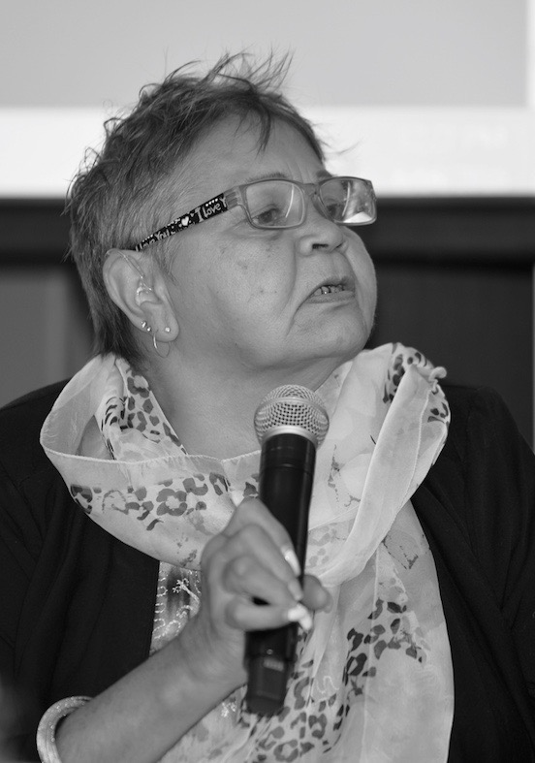
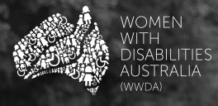
‘Strengthening voice and visibility of women and girls with disability’
By Carolyn Frohmader
© Copyright WWDA 2016

Slide 2
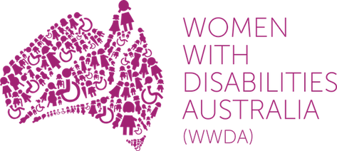
About Women With Disabilities Australia (WWDA)
Women With Disabilities Australia (WWDA) is the award winning, national Disabled People’s Organisation (DPO) for women and girls with all types of disability in Australia. WWDA operates as a transnational human rights organisation and is run by women with disability, for women with disability.
WWDA’s work is grounded in a human rights framework which links gender and disability issues to a full range of civil, political, economic, social and cultural rights.
WWDA’s work at all levels illustrates that women and girls with disability are best positioned to identify and determine their own rights, needs, will and preferences and to make decisions concerning their circumstances and conditions.

Slide 3
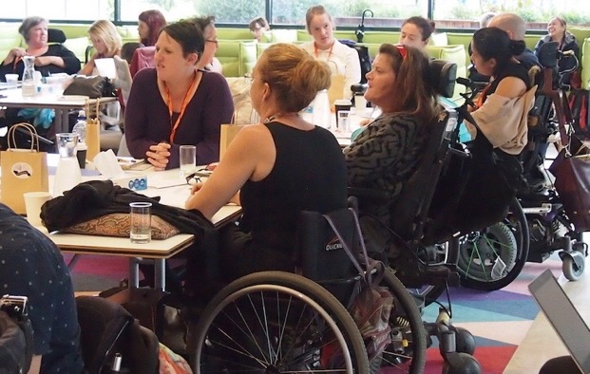
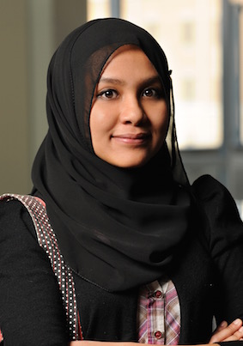
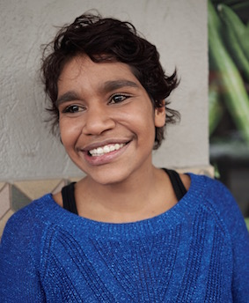
Key Principles that underpin WWDA’s work
1. Participation, decision-making & capacity building
Women and girls with disability are best positioned to determine their own rights, needs, will and preferences & to make decisions about their circumstances and conditions.
2. Intersectionality
Intersectional discrimination has compounding effects on women and girls with disability and requires particular consideration and remedying.
3. Stakeholder Engagement & Cross-Sector Collaboration
Requires and involves a “twin-track approach”, that is, focusing on 'stand-alone' work on the rights and freedoms of women and girls with disability, whilst working with mainstream policy, programs, organisations and services to ensure the integration of a human rights approach and a gendered-disability analysis and perspective.

Slide 4
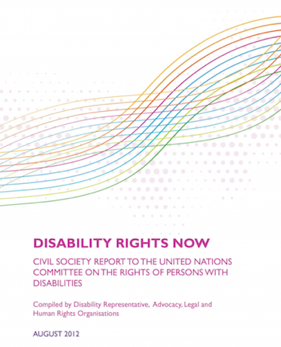
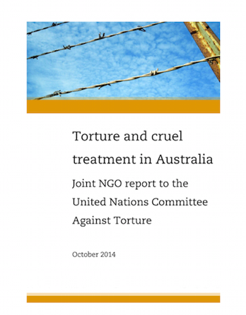
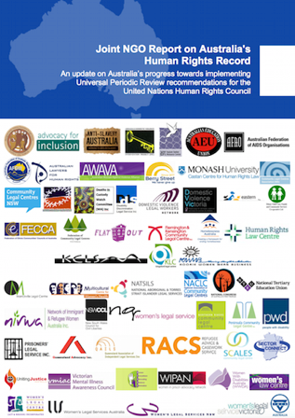
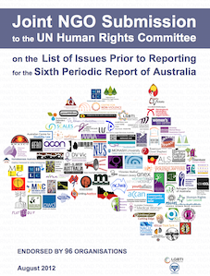
WWDA’s key strategies to strengthen voice and visibility of women and girls with disability
1. Applying a holistic human rights framework
Using the full range of International Human Rights Treaties to which Australia is a party [not just the CRPD] - WWDA’s work utilises and is framed by, these seven international human rights treaties. Makes extensive use of the Universal Periodic Review (UPR) process.
UN Shadow Reporting - WWDA contributes formal stand alone Shadow Reports in our own right, and also works as a member of national NGO/CSO Coalitions established to develop Shadow Reports to supplement the Australian Government periodic reports to the relevant treaty-monitoring bodies.
Notes:
These seven treaties are: Convention on the Elimination of All Forms of Racial Discrimination on 21 December 1965 ([1975] ATS 40); International Covenant on Economic, Social and Cultural Rights on 16 December 1966 ([1976] ATS 5); International Covenant on Civil and Political Rights (ICCPR) on 16 December 1966 ([1980] ATS 23); Convention on the Elimination of All Forms of Discrimination against Women on 18 December 1979 ([1983] ATS 9); Convention against Torture and Other Cruel, Inhuman or Degrading Treatment or Punishment (CAT) on 10 December 1984 ([1989] ATS 21); Convention on the Rights of the Child on 20 November 1989 ([1991] ATS 4); Convention on the Rights of Persons with Disabilities [2008, ATS 12].

Slide 5
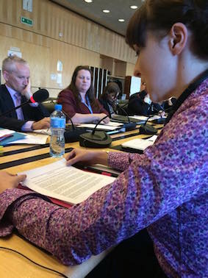
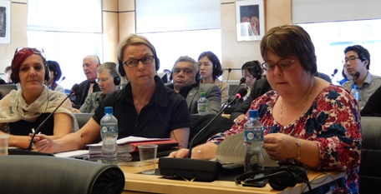
1. Applying a holistic human rights framework…cont’d
Using UN Treaty Body General Comments - to articulate in detail, Australia’s obligations under the international human rights treaties to which Australia is a party.
NGO Delegations to UN Treaty Body Compliance Reviews and the UPR reviews - presence, visibility and active engagement of women with disability at formal UN treaty body compliance reviews of States Parties is critical.
WWDA has had particular influence when we have been an active member of NGO/CSO delegations – lobbying, meeting with treaty body Committee members, giving formal presentations to Committees, assisting in drafting Concluding Observations/Recommendations etc.

Slide 6
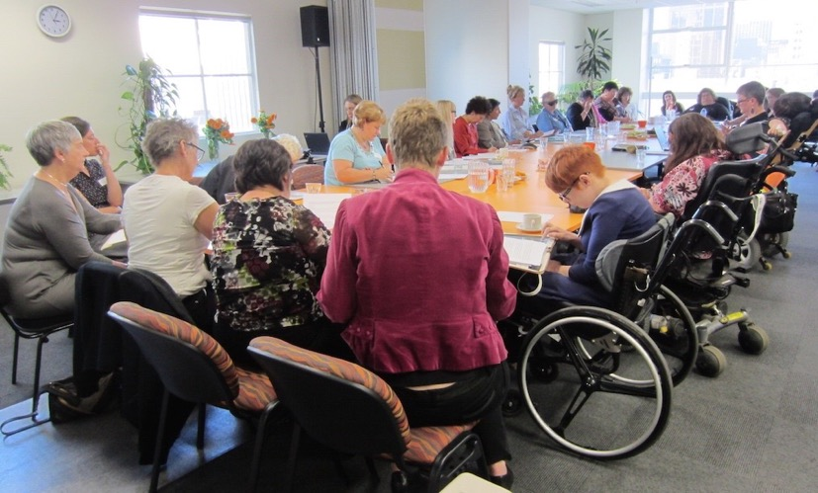
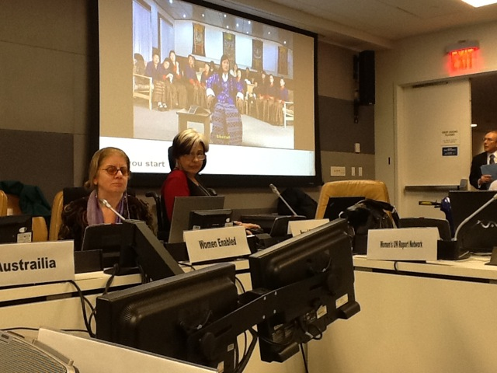
1. Applying a holistic human rights framework…cont’d
Working with the UN Special Procedures - WWDA routinely and regularly engages with the UN Special Rapporteurs by providing them with our reports, research, articles, case studies, as well as participating in and contributing to, the work of the Special Rapporteurs.
For eg: in 2012 the Special Rapporteur on Violence Against Women visited Australia. WWDA organised a Roundtable of Women with Disability where the SR met with women with disability to discuss violence against women with disability.
Using the UN Charter Based Bodies - Visibility of WWDA and our sister colleagues at CSW has seen more emphasis given to women with disability in the Agreed Conclusions stemming from sessions of CSW. Have run and co-sponsored Side Events at CSW.

Slide 7
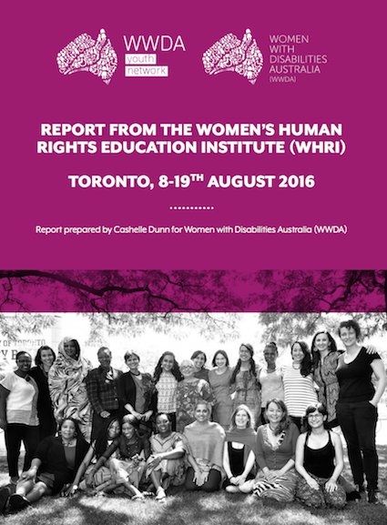
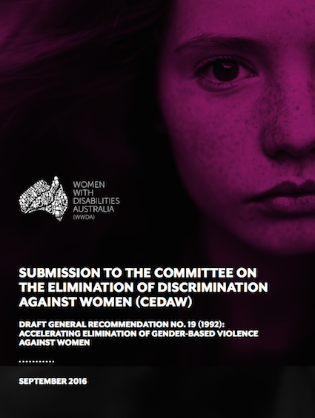
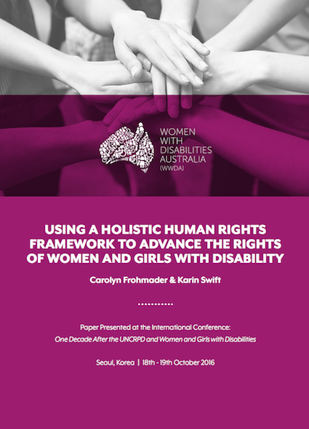
1. Applying a holistic human rights framework…cont’d
WWDA routinely and regularly engages with the UN treaty body monitoring Committees and UN agencies by providing them with our reports, research, articles, case studies, and so on.
This has proven to be an important and worthwhile strategy - WWDA has received feedback from UN Committees and agencies acknowledging the importance and influence of WWDA’s work.

Slide 8
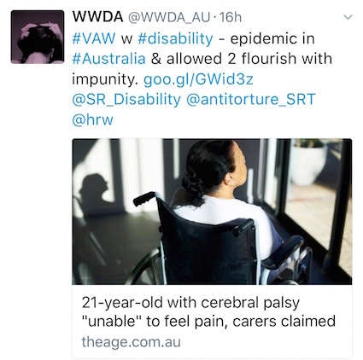
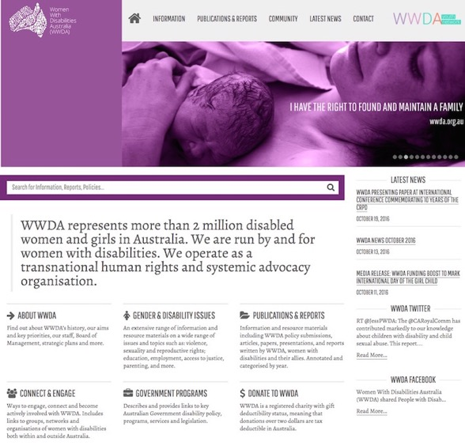
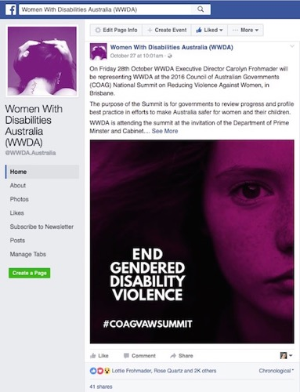
2. Establishing engagement opportunities & building capacity
WWDA offers full Membership for women and girls with disability and associate membership for supporters. All memberships are free of charge.
WWDA provides a range of mechanisms for women and girls with disability to be actively involved in the organisation. Social media and other digital platforms are critical communication and engagement tools for WWDA due to limited resourcing and capacity.

Slide 9
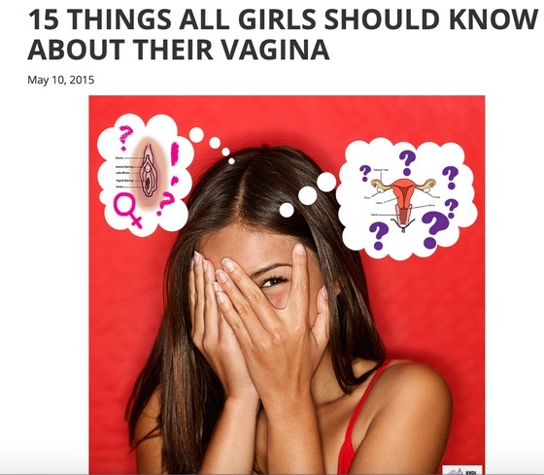
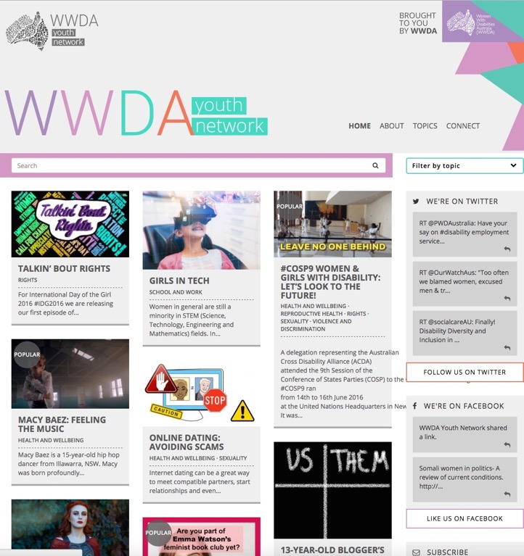
2. Establishing engagement opportunities & building capacity….cont’d
Established the WWDA Youth Network in 2014. Created by and for girls and young women with disability aged 13-20yrs. Is organic, interactive and distributed across a range of platforms including Facebook, Twitter, Instagram, YouTube and its own website (www.youth.wwda.org.au).
WWDA Youth Network was launched by the Minister for Women in July 2015. See:
http://wwda.org.au/wwda-youth-network-launch-a-resounding-success/

Slide 10
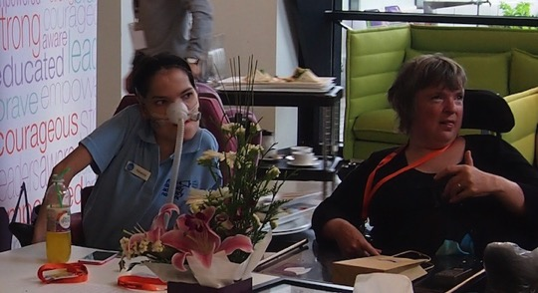
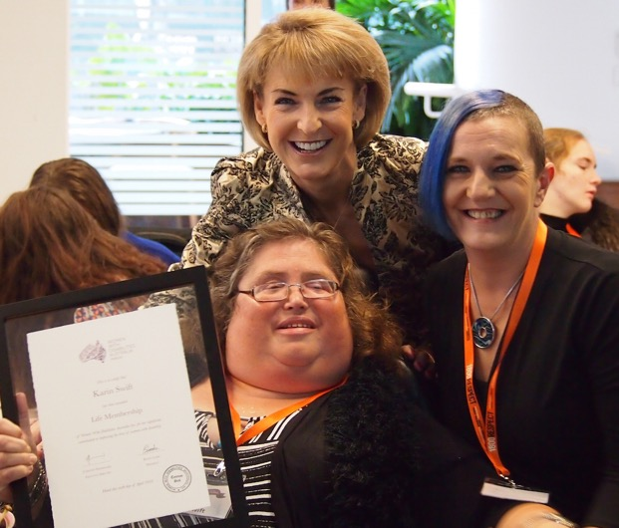
2. Establishing engagement opportunities & building capacity….cont’d
Conducted the National Forum of Women & Girls with Disability in 2016. Attended by 60 women and girls with disability from around Australia. Also attended by Minister for Women and representatives from key Government agencies, enabling women with disability to actively engage with Govt on key issues.
National Forum prioritised key issues affecting women and girls with disability in Australia which require urgent action from duty bearers:
All forms of violence against women and girls with disability
Economic empowerment
Sexual and reproductive rights
Participation and Representation
Decision-Making

Slide 11
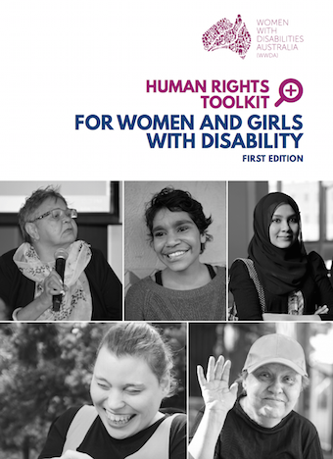
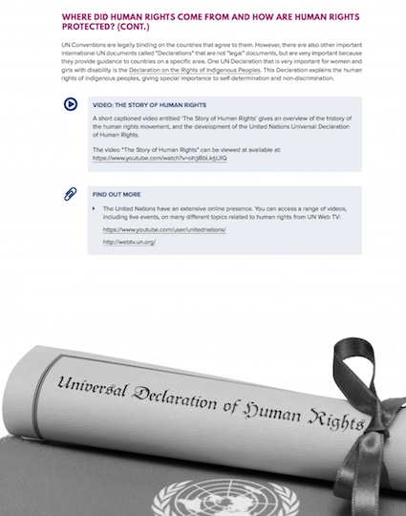
2. Establishing engagement opportunities & building capacity….cont’d
In late 2016, as one of the outcomes of the WWDA National Forum, WWDA developed a Human Rights Toolkit for women and girls with disability.

Slide 12
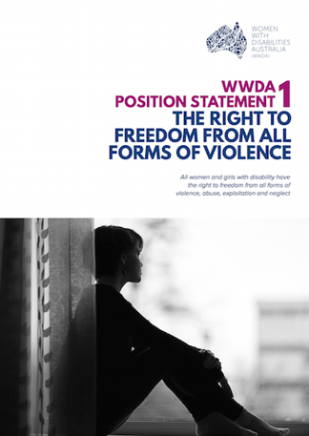
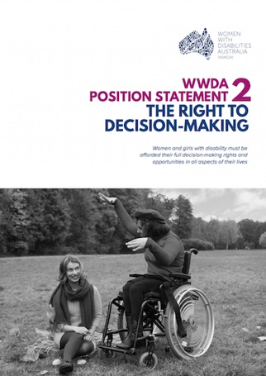
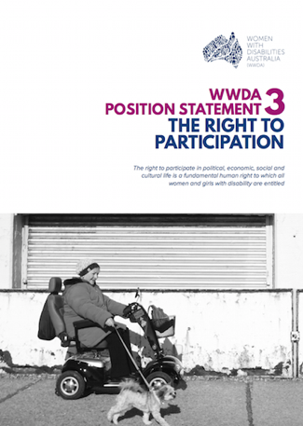
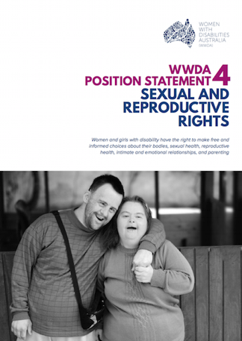
2. Establishing engagement opportunities & building capacity….cont’d
The WWDA Human Rights Toolkit is supplemented by comprehensive WWDA Position Statements on the priority human rights issues identified by women and girls with disability.
Each of the Position Statements include: WWDA’s position on the issue; the evidence base; Australia’s international human rights obligations relating to the issue; Australia’s compliance with its human rights obligations relating to the issue; as well as a set of recommendations as to how Australia can advance the rights of women and girls with disability in relation to the issue.

Slide 13
2. Establishing engagement opportunities & building capacity….cont’d
The WWDA Human Rights Toolkit is also supplemented by five videos made by women and girls with disability from around Australia.
Video 1: Women with disability talk about why human rights are important
https://youtu.be/f0zH1cnDosM
Video 2: Women with disability talk about the right to decision-making
https://youtu.be/NaEYW-spW2g
Video 3: Women with disability talk about the right to freedom from violence
https://youtu.be/Tmp5_3Ho6iA
Video 4: Women with disability talk about the right to the right to parent
https://youtu.be/6s8bDQptAlw
Video 5: Women with disability talk about the right to employment
https://youtu.be/jGAyWWDDnII

Slide 14

3. Forming strategic alliances, coalitions & working collaboratively
WWDA recognises that mutually beneficial relationships achieve outcomes that extend beyond what WWDA can achieve in isolation.
WWDA works in partnership with UN agencies (eg: UNFPA, WHO, UN Women) on programs, also works in partnership with the private sector on specific projects.
WWDA is a founding member of Disabled People’s Organisations Australia (DPOA) – a new and innovative alliance of four national DPO’s in Australia.
The four national DPO’s that make up DPO Australia are:
Women With Disabilities Australia (WWDA)
First Peoples Disability Network (FPDN)
National Ethnic Disability Alliance (NEDA)
People With Disability Australia (PWDA)
The key purpose of DPOA is to promote, protect and advance the human rights and freedoms of people with disability in Australia by working collaboratively on areas of shared interests, purpose and strategic opportunity.
With its strong focus on intersectionality, DPO Australia is a critical mechanism to strengthen voice and visibility of women and girls with disability.

Slide 15
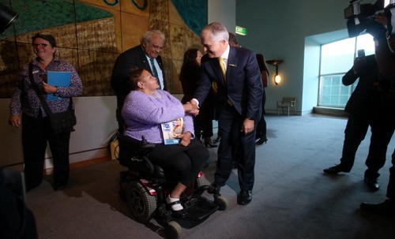
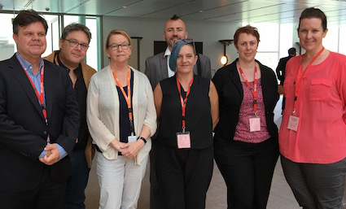

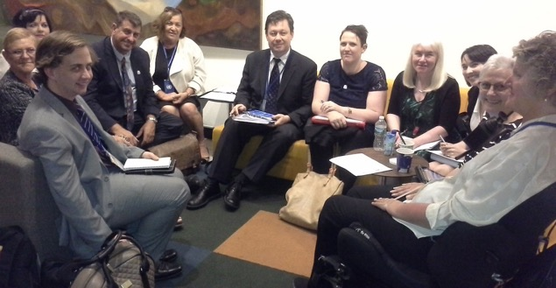
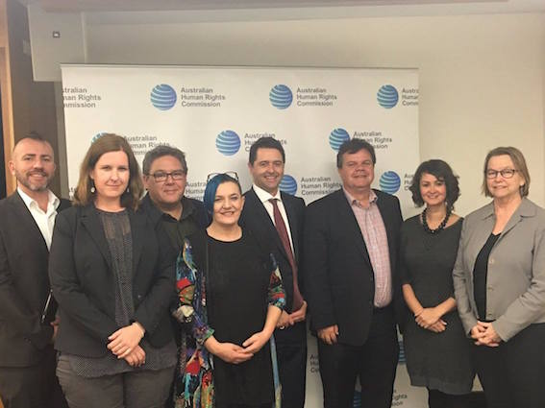
3. Forming strategic alliances, coalitions & working collaboratively…cont’d
DPOA works on joint initiatives and projects:
DPOA delegation to the CRPD COSP in June 2016;
DPOA national campaign which led to the Senate Inquiry into Violence against people with disability in institutional and residential settings;
DPOA Federal Election Platform Campaign;
DPOA Summit with all Australian Human Rights Commissioners – to promote and focus on the AHRC working in a more intersectional way to advance the rights of people with disability;

Slide 16
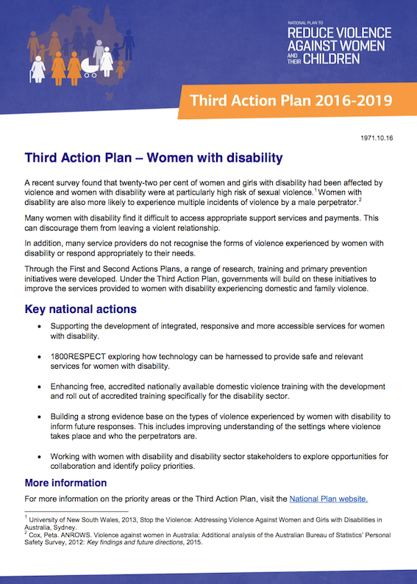
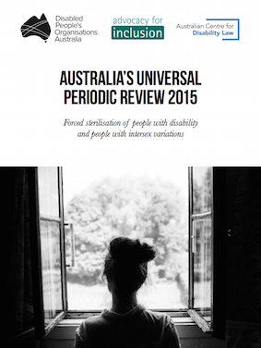
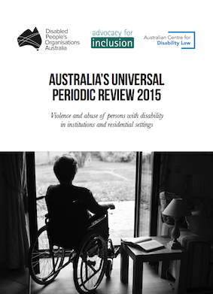
3. Forming strategic alliances, coalitions & working collaboratively…cont’d
DPOA campaign on the Third Action Plan under the Australian Government’s 12 year National Action Plan to Reduce Violence Against Women and their Children - to ensure that the Third Action Plan responds to, and addresses, all forms of violence against all women, regardless of the setting or place in which it occurs, and regardless of who perpetrates it.
DPOA UPR NGO Project - coordinated the UPR Disability Coordination Group on behalf of the Australian UPR NGO Human Rights Coalition (over 200 NGOs), participating in the UPR pre-sessional meetings and participating in the delegation to the UPR at the UN in Geneva.

Slide 17


Women with Disabilities Australia (WWDA)
PO Box 407, Lenah Valley TASMANIA 7008 AUSTRALIA
Ph: +61 438 535 123
E: carolyn@wwda.org.au W: www.wwda.org.au
FB: www.facebook.com/WWDA.Australia
Twitter: https://twitter.com/WWDA_AU
Contact: Carolyn Frohmader (Executive Director)
Winner, National Human Rights Award 2001
Winner, National Violence Prevention Award 1999
Winner, Tasmanian Women's Safety Award 2008
Certificate of Merit, Australian Crime & Violence Prevention Awards 2008
Nominee, French Republic's Human Rights Prize 2003
Nominee, UN Millennium Peace Prize for Women 2000
Disabled People’s Organisations Australia
PO Box 666, Strawberry Hills NSW 2012
AUSTRALIA
Ph: +61 2 9370 3100
Ph: +61 412 935 128
E: director@dpoa.org.au W: http://dpoa.org.au
Twitter: https://twitter.com/DPOAustralia
Contact: Therese Sands (Director)

